Slide 1
Go-Nogo task!
This presentation includes instructions in the order that they will appear.

Slide 2
Welcome to the animal learning game!
In this game, you will interact with different animals. You will choose whether or not to press a button after seeing each of these animals. If you respond correctly, some of them will help you gain money, and some others will help you avoid losing money.
Each trial includes 3 stages:
Animal → Button response → Feedback
Press spacebar to continue

Slide 3


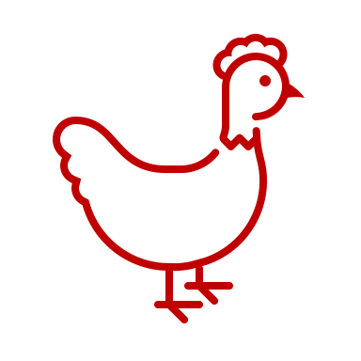

Animals
First, you are going to see 4 different animals in this game. They will tell you whether to respond or not, and whether a correct response will earn you money or prevent you from losing money.
Press spacebar to continue

Slide 4
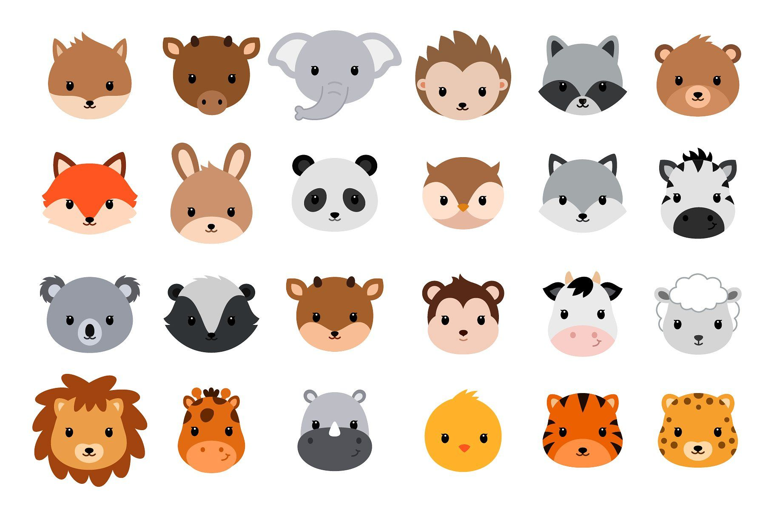
Animals
Note: these cartoon animal faces might be good in that
they don’t display too much emotion and are cute
and colorful. You can circle those that you feel are the most
appropriate to use as the cue stimuli.
First, you are going to see 4 different animals in this game. They will tell you whether to respond or not, and whether a correct response will earn you money or prevent you from losing money.
Press spacebar to continue

Slide 5
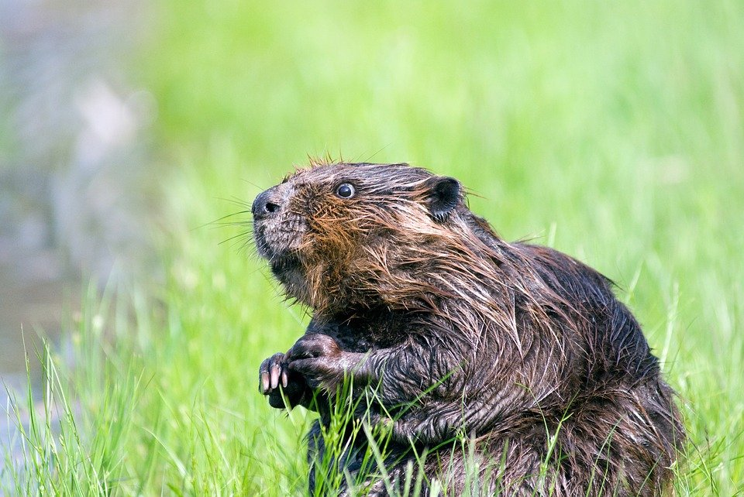
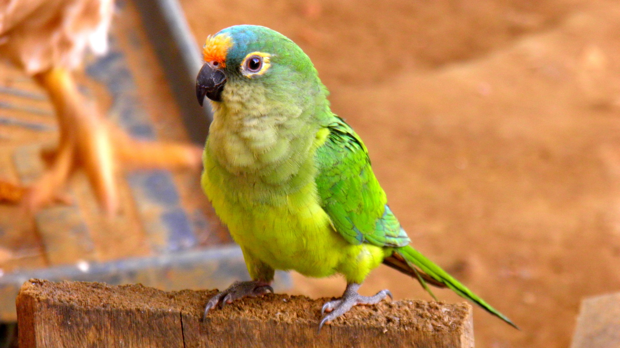
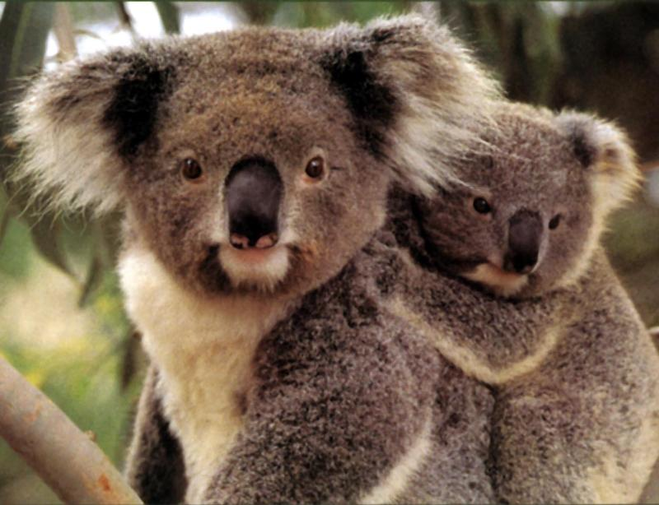
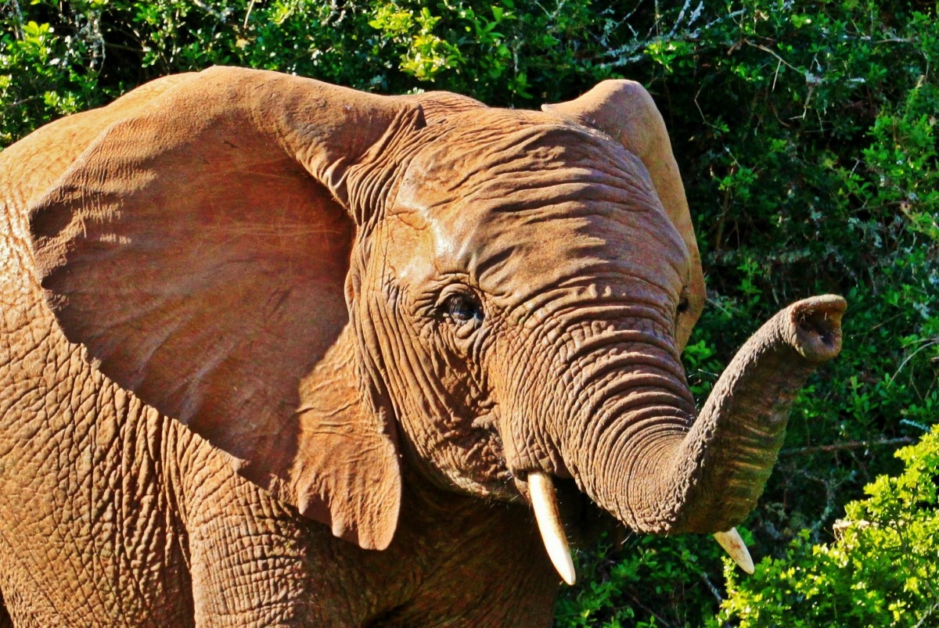
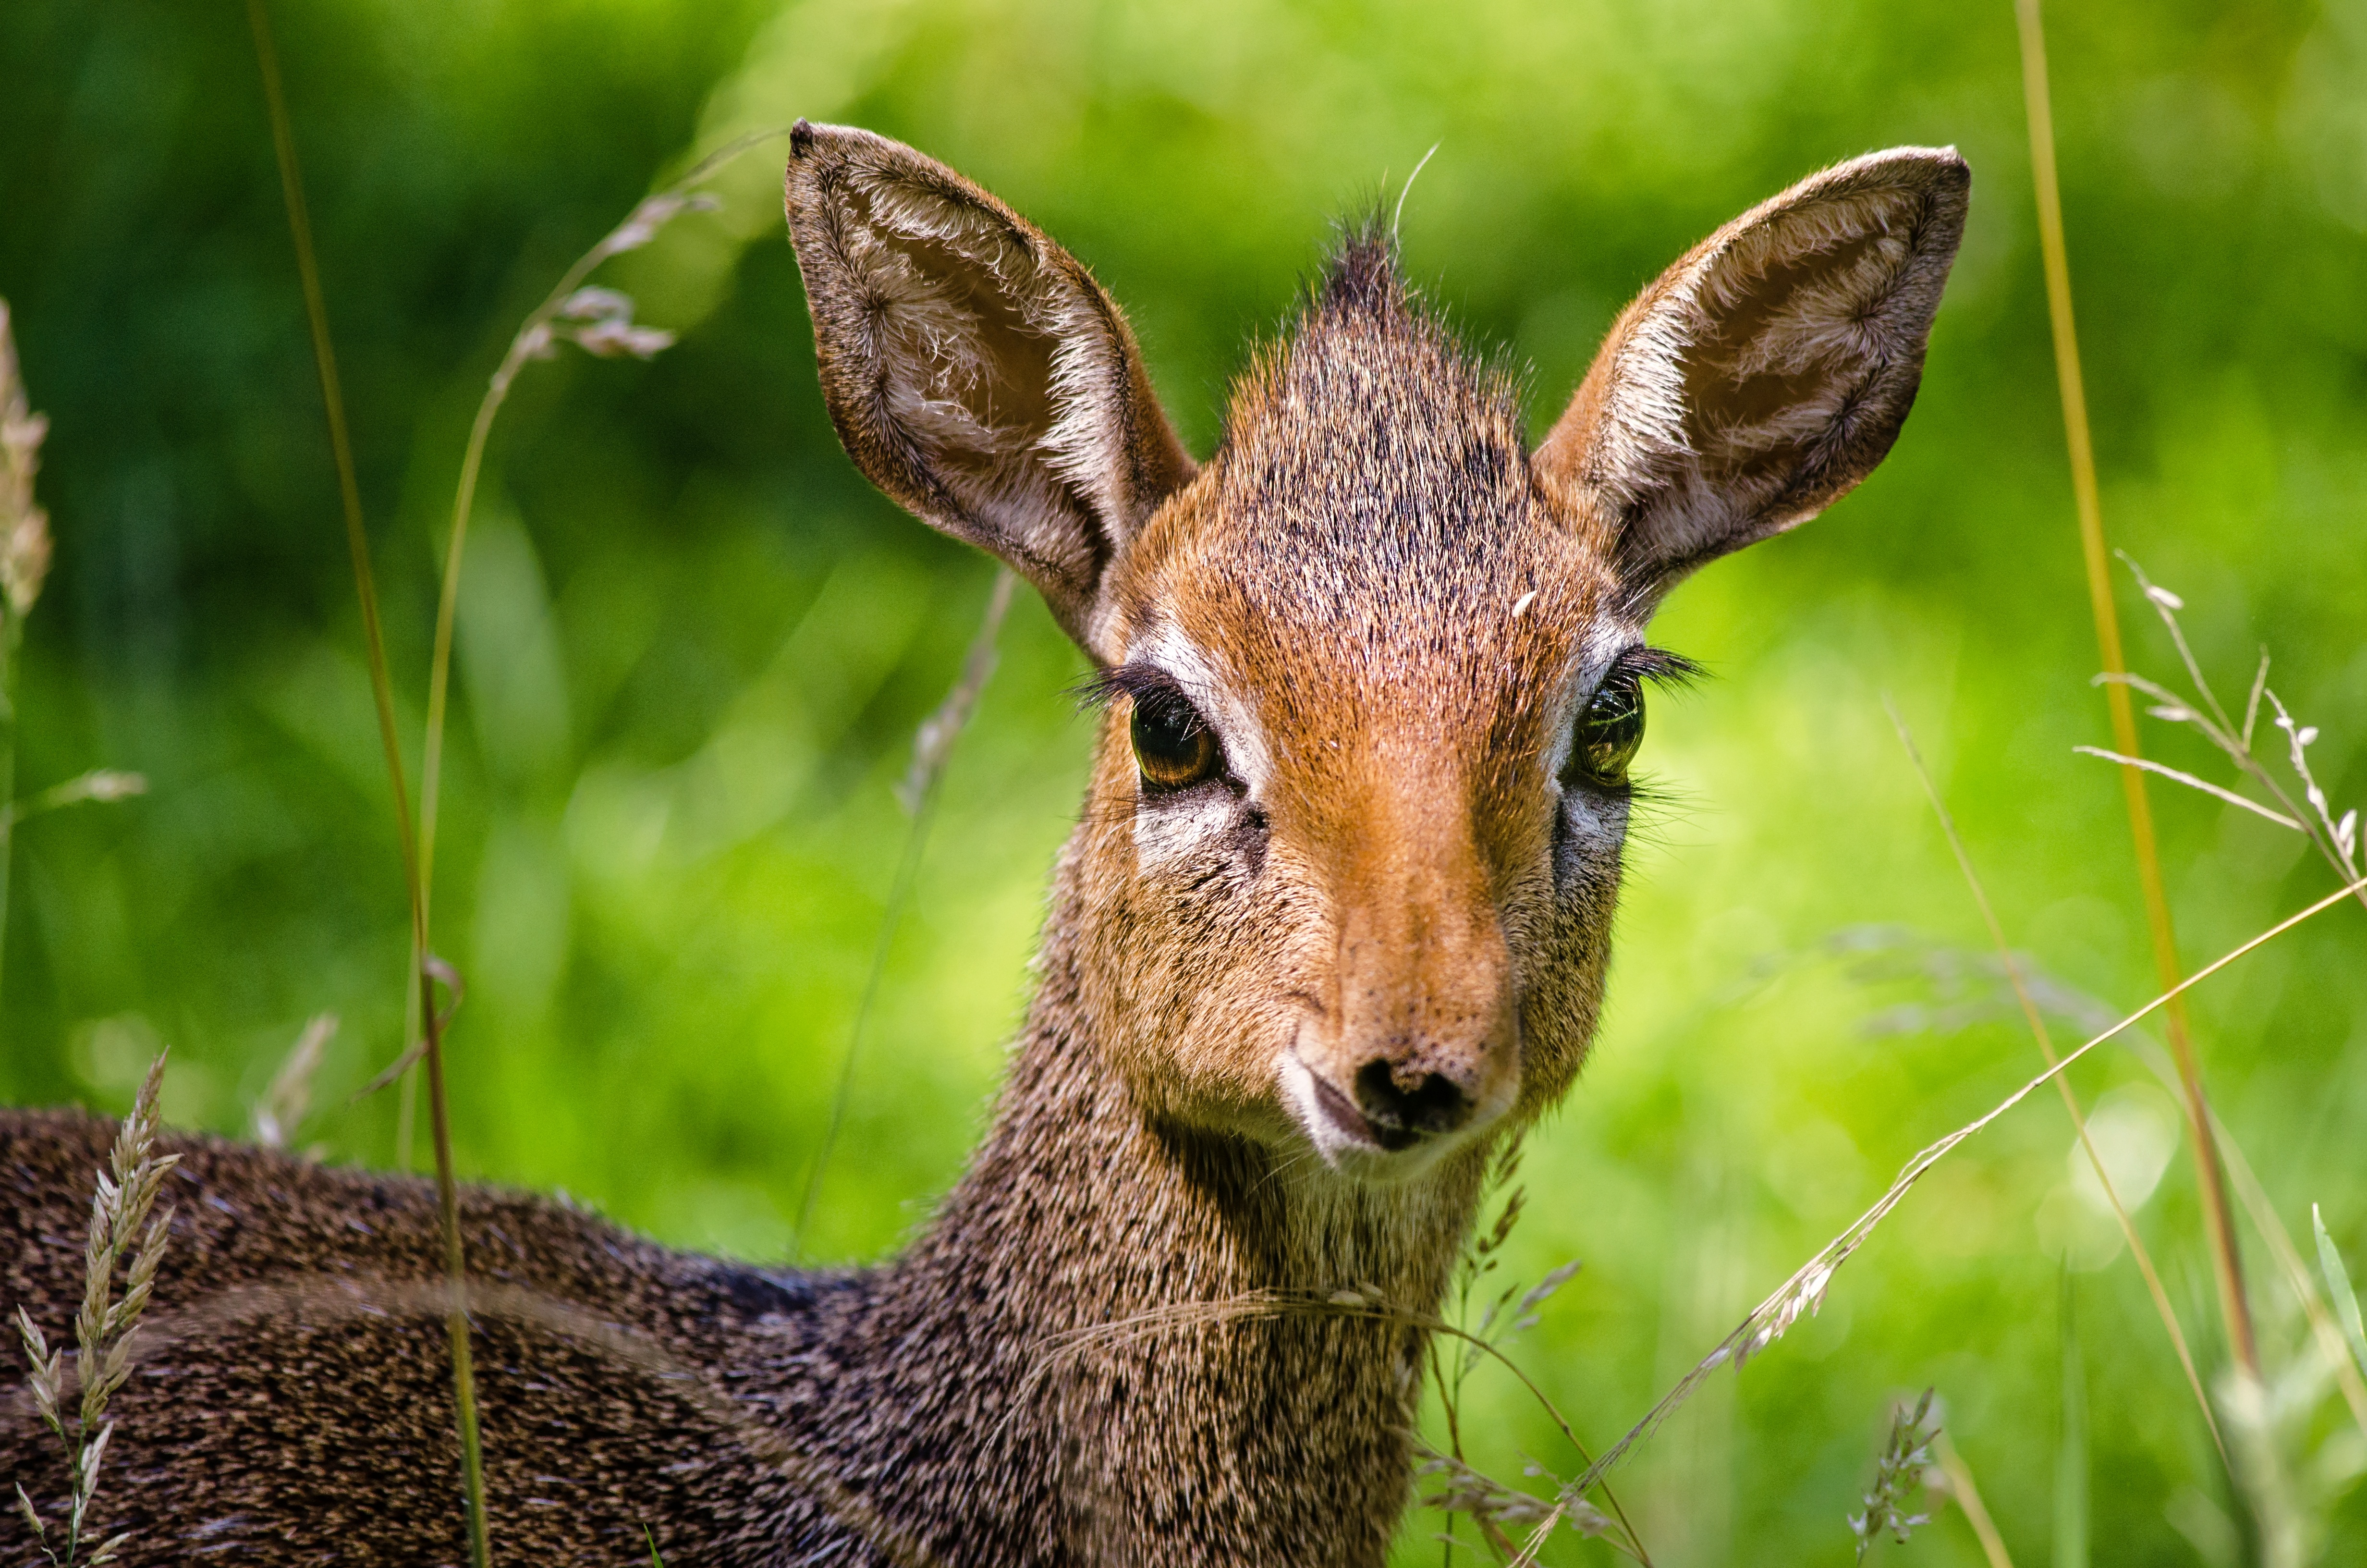
Animals
Note: photos of animal. They are richer to look at than cartoon
pictures. We might prefer cartoon animals for simplicity, but these
ones might be more interesting to look at.
First, you are going to see 4 different animals in this game. They will tell you whether to respond or not, and whether a correct response will earn you money or prevent you from losing money.
Press spacebar to continue

Slide 6

button
After seeing the animal, this button will appear either left or right. When you think you should respond, press the arrow corresponding to the side of the screen that the button is on.
Press spacebar to continue

Slide 7



feedback
After your response, you can get your feedback! Some animals are associated with gaining money if you respond to the button correctly (smiling face) and nothing if you do not (neutral face). Others will make you lose money if you respond incorrectly (sad face) and a neutral face if you respond correctly.
Press spacebar to continue

Slide 8



feedback
After your response, you can get your feedback! Some animals are associated with gaining money if you respond to the button correctly (thumb up) and nothing if you do not (a leveled bar). Others will make you lose money if you respond incorrectly (thumb down) and a leveled bar if you respond correctly.
Press spacebar to continue

Slide 9

feedback
50 points
50 points
After your response, you can get your feedback! Some animals are associated with gaining money if you respond to the button correctly (add 10 points) and nothing if you do not (a leveled bar). Others will make you lose money if you respond incorrectly (minus 10 points) and a leveled bar if you respond correctly.
no change
Press spacebar to continue

Slide 10
Let’s walk it through!

Slide 11
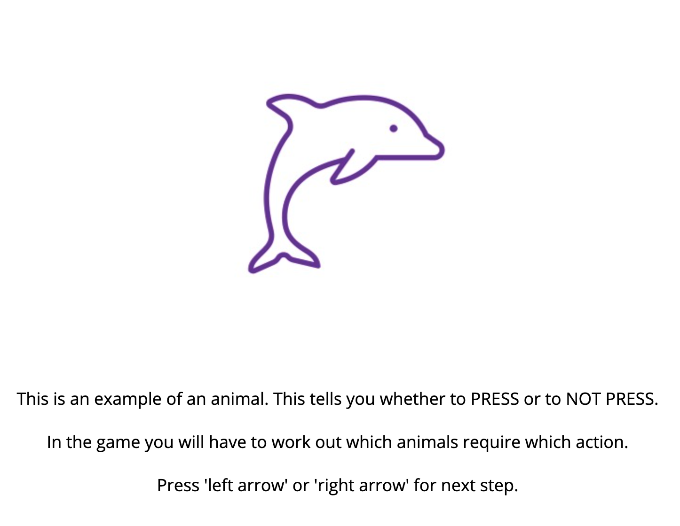
Screenshot from online

Slide 12
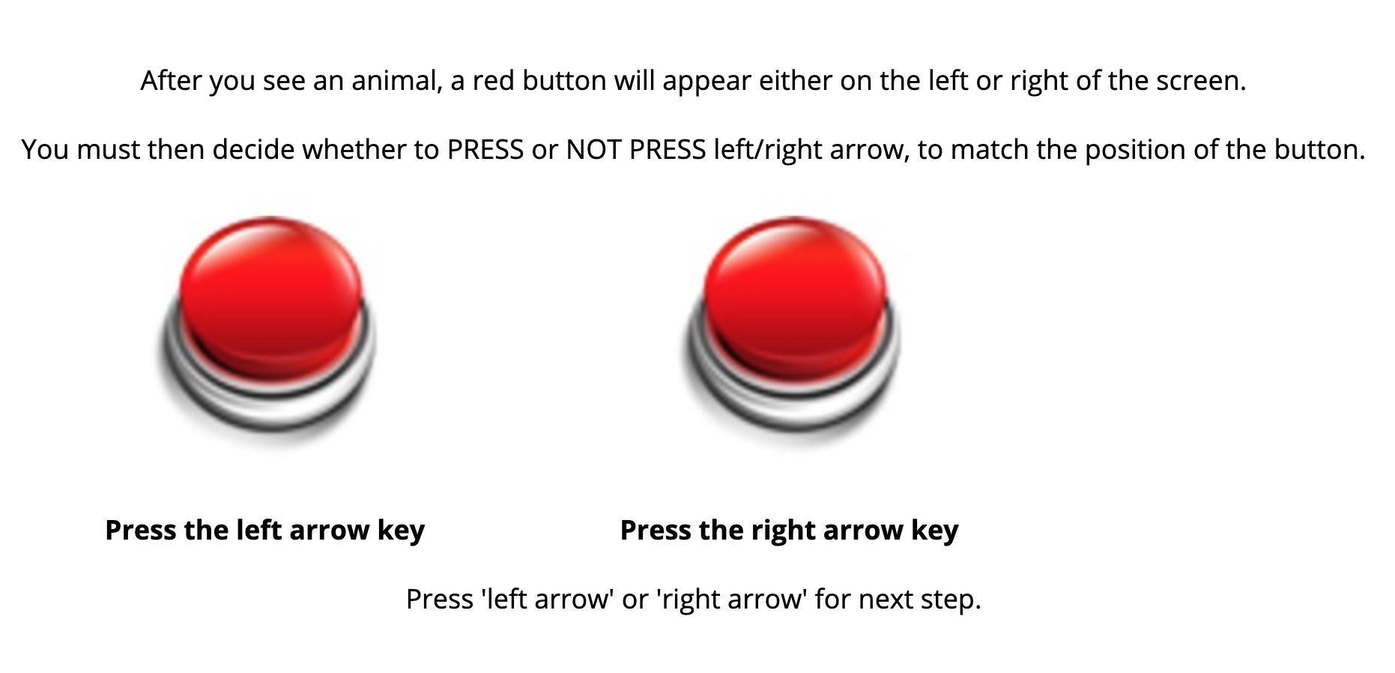
Screenshot from online

Slide 13
There is a time limit within which you must press the red button (1 SECOND). Remember, you can CHOOSE to press or not.
Sometimes you will WIN money for doing the right thing, and other times you will AVOID LOSING money for doing the right thing.
Press spacebar to continue

Slide 14
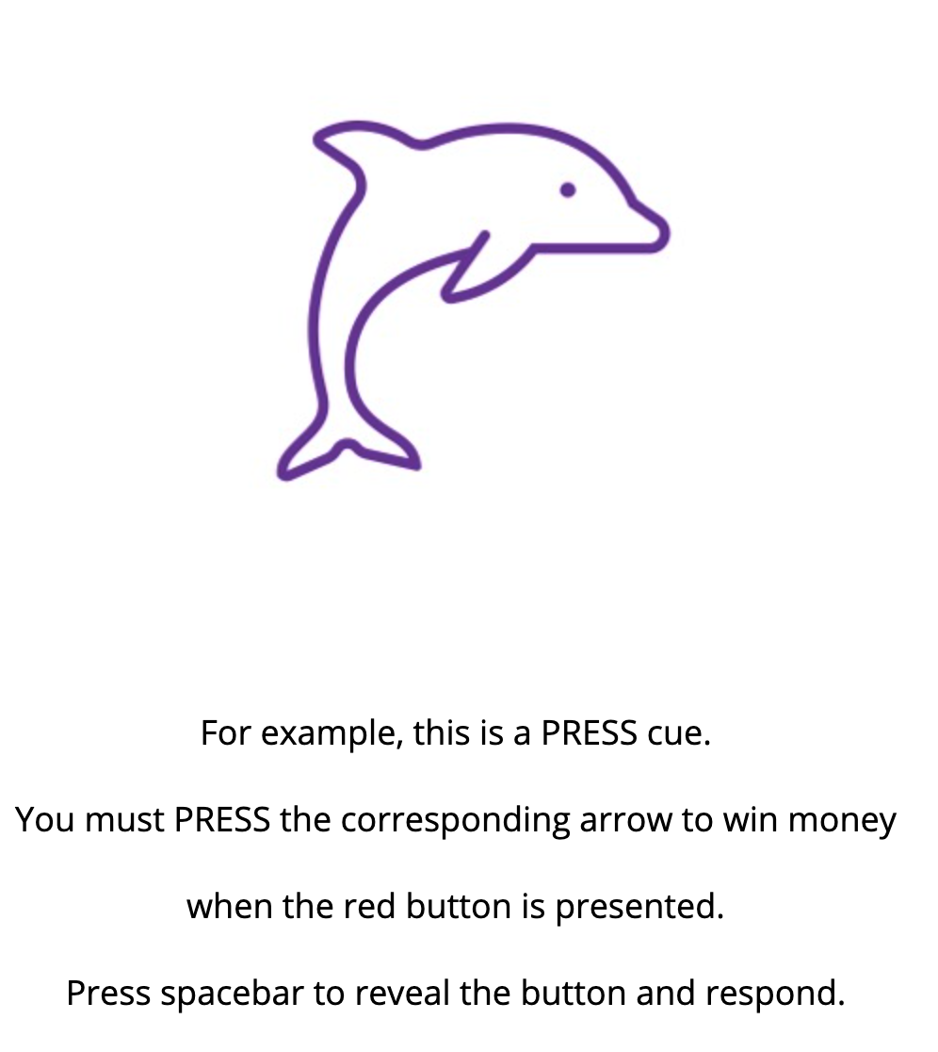
Screenshot from online; this is followed by a right button and a thumb up

Slide 15
Well done!
You’ll now do some practice in which we’ll tell you which animals you need to PRESS and NOT PRESS for. In the real game you'll have to work this out for yourself.
This part doesn‘t count for money, but in the real game you gain 50 points every time you see a (stimuli) and lose 50pc for each (stimuli). These will affect your final earnings.
Press spacebar to start training

Slide 16







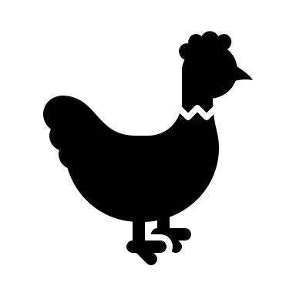
stimuli

Slide 17




Shapes

Slide 18
Button

Slide 19
Feedback

Slide 20





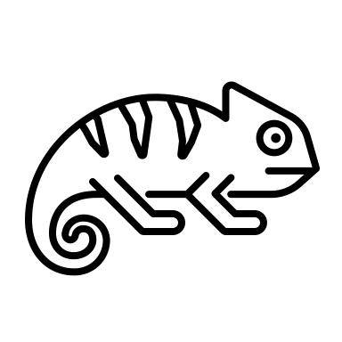
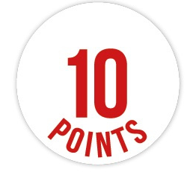





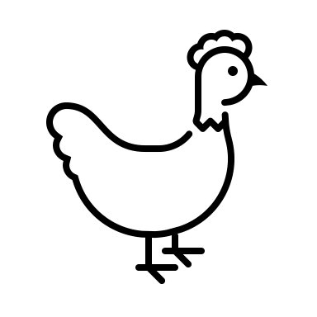
Feedback

